Slide 1
Wow Technical Deliverable
RDIOP-343:Logging Configuration in Mapr

Slide 2
Problem Statement
The Partition /opt/mapr on the node is running out of space(95% full)
Ref for the ticket: https://wcdma-jira.rnd.ki.sw.ericsson.se/browse/RDIOP-343

Slide 3
Solution Delivered/Implemented
Technical Details of the Solution:-
In a MapR cluster, the logging option that you configure defines how the logs are stored and accessed.
Centralized logging. The logs are written to local volumes on the MapR file system.
YARN log aggregation. The logs are written to the local file system and then the container logs from each node are aggregated and stored on the MapR file system.

Slide 4
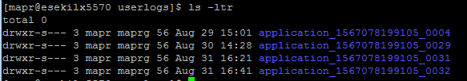
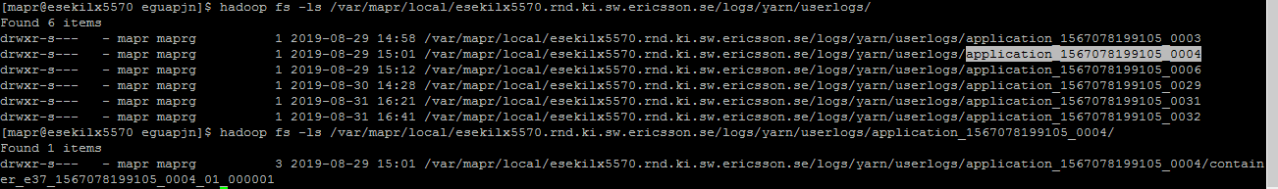
Implementation steps:
Enabling Centralized Logging:
Configure the yarn.use-central-logging-for-mapreduce-only property in the yarn-site.xml file to enable centralized logging
To enable centralized logging, set the value of yarn.use-central-logging-for-mapreduce-only to true in yarn-site.xml.
Restart all ResourceManagers
Viewing Logs for Completed MapReduce Version 2 Applications
local filesystem: /opt/mapr/hadoop/hadoop-2.7.0/logs/userlogs
MapR fs: /var/mapr/local//logs/yarn/userlogs/

Slide 5
Enabling YARN Log Aggregation
Configure the yarn.log-aggregation-enable property in the yarn-site.xml file to enable YARN Log Aggregation logging
To enable centralized logging, Set the value of yarn.log-aggregation-enable to true in yarn-site.xml.
Restart all ResourceManagers
View Logs for Completed Applications
Determine the application ID for the application that you want to view the logs for. For example, run the following command to list the applications: yarn application -list
yarn application -list
Run the yarn logs command to view the logs for the application. For example, run the following command to view the log files for application application_1415822090718 yarn logs -applicationId application_1415822090718
yarn logs -applicationId application_1415822090718
Aggregated logs are owned by the user who runs the job. For example, when user admin runs a job, the logs are stored to maprfs:///tmp/logs/admin. If user analyst runs a job, the logs are stored to maprfs:///tmp/logs/analyst

Slide 6

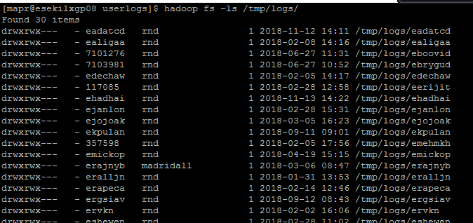
local filesystem: /opt/mapr/hadoop/hadoop-2.7.0/logs/userlogs
MapR fs: hadoop fs -ls /tmp/logs/
Optional:Set the value of yarn.nodemanager.remote-app-log-dir to a location in the MapR-FS. By default, the location is maprfs:///tmp/logs.

Slide 7
Using the HistoryServer UI to View Logs for Completed Applications
You can view the logs in the HistoryServer UI)
View Logs in the HistoryServer UI Launched Using MapR Control System
Log on to the MCS and click Services to display the list of services installed on the cluster.
Click the HistoryServer link in the list of services to open the Job History page in a new tab.
Click the Job ID link for the job you want to view the logs for.
Click the logs link in the Logs column of the Application Master section.
View Logs Using the HistoryServer UI
Go the URL similar to the following to open the Job History page:
<IP address of HistoryServer node>:19890
Click the Job ID link for the job you want to view the logs for.
Click the logs link in the Logs column of the Application Master section.

Slide 8
Advantages
If centralized logging and YARN log aggregation are enabled, the logs for MapReduce v2 applications will be managed by Centralized Logging while the logs for non-MapReduce applications will be managed by YARN log aggregation. And we can Free up space in /opt/mapr on the nodes.
Additional Command(Centralized Logging)
Command Line to View Logs for Completed Applications
Use the maprcli job linklogs command to create centralized logs for completed applications.
maprcli job linklogs -jobid application_1434605941718_0001 -todir /logsdir
To determine where the logs are located, run the following command on the directory that contains the symlinks to the log files for a specific container:
hadoop fs -ls <todir>/<applicationID>/hosts/<hostName>/<containerID>

